Slide 1


Brit Connect Network Performance Dashboard
BY: OLUWATOSIN ADENIRAN

Slide 2





INTRODUCTION
The organisation's disconnected systems restricted effective monitoring of outage causes, customer impact, restoration performance, and SLA compliance.
To address these challenges, the project integrated outage, alarm, customer, vendor, maintenance, and SLA data into a star-schema data model.
SQL Server was used for data preparation, while Power BI was employed to develop interactive dashboards that support network performance monitoring and service improvement.
Brit Connect Mobile & Broadband Ltd., a UK telecommunications provider, was found to experience frequent network outages and service disruptions across its mobile and broadband services.

Slide 3





Project OBJECTIVES
Build a centralized outage analytics database in SQL Server
1
Integrate outage, alarm, SLA, vendor, maintenance, and customer data.
2
Monitor key network performance KPIs (MTTR, MTTD, SLA, downtime).
3
Analyze outage trends, root causes, and customer impact.
4
Identify recurring faults, high-risk sites, and underperforming vendors.
5
Evaluate SLA compliance and network service reliability.
6
Deliver interactive Power BI dashboards for operational and strategic decision-making.

Slide 4

KEY PERFORMANCE INDICATOR
• Total Outages: 5,000 ⚠️
• Resolved Incidents: 5,000
• SLA Evaluated: 3,456 📋
• SLA Compliance: ~80% 📊
• Average MTTD: 17.74 minutes ⏱️
• Average MTTR: (36.59 minutes)🔧
✅

Slide 5
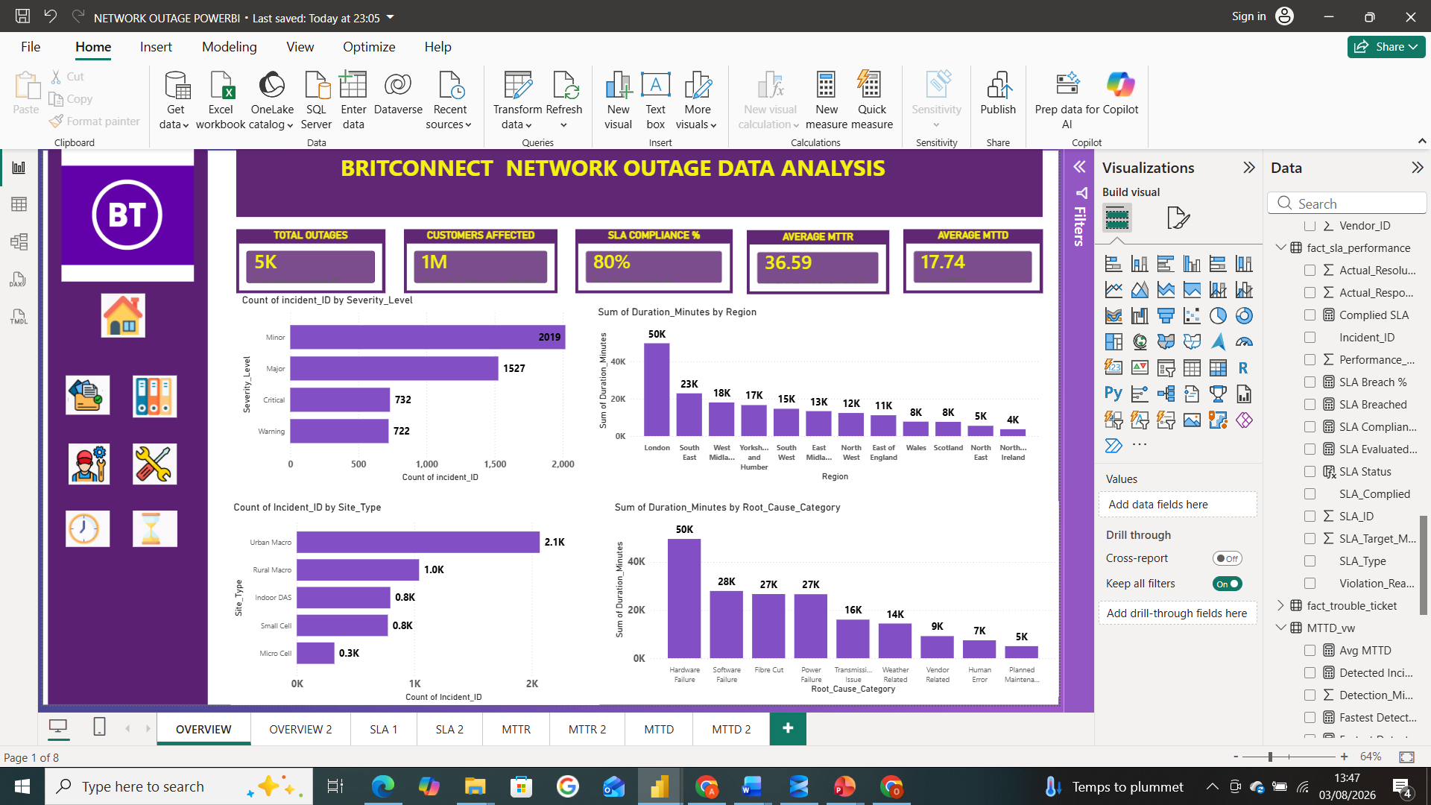
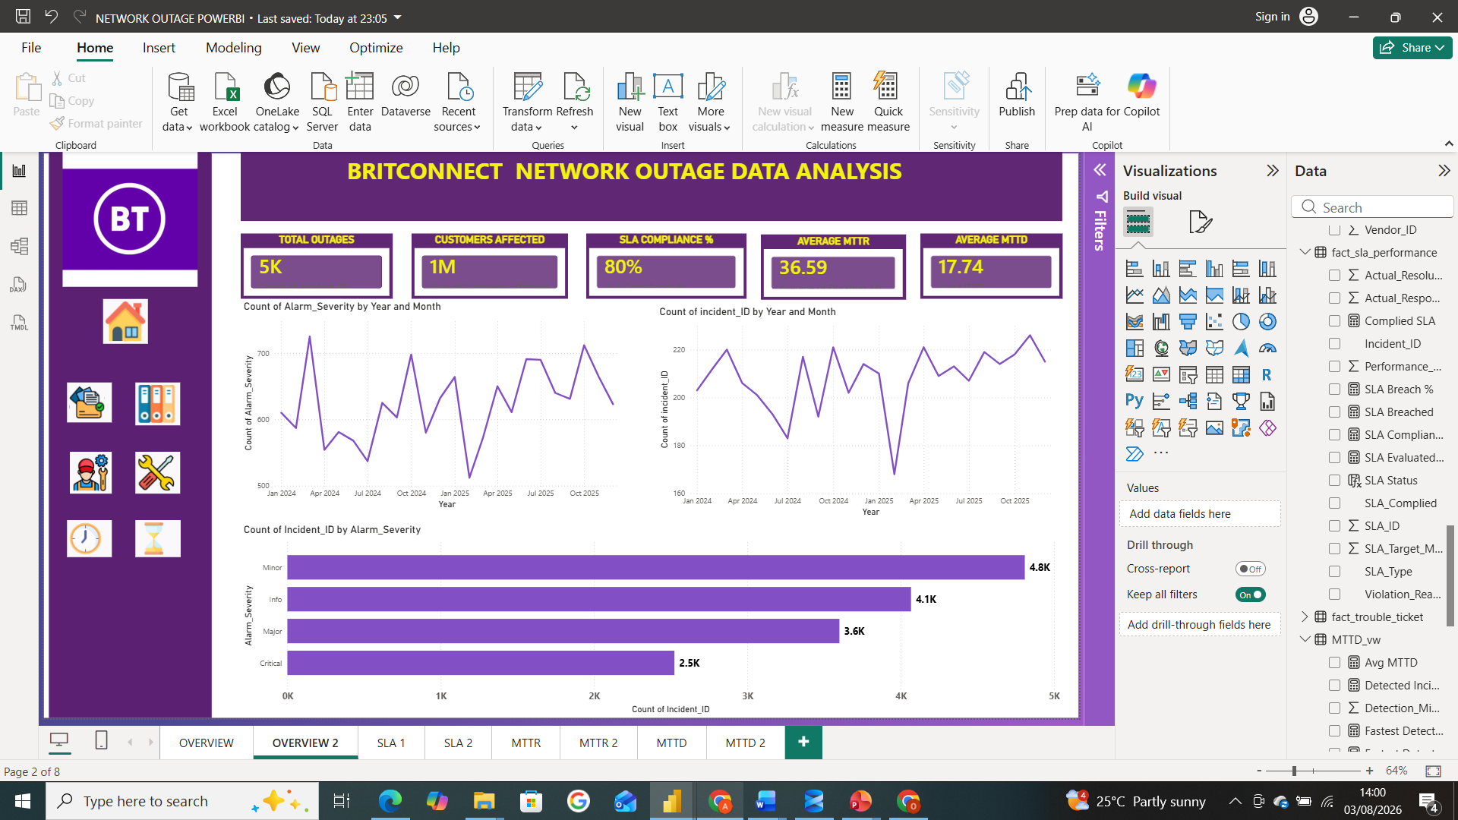
OVERVIEW
183 Minutes Total
Root causes of the outages.
The severity level of the outages,
Site type categories for outages,
Alarm severity year and monthly trend,

Slide 6
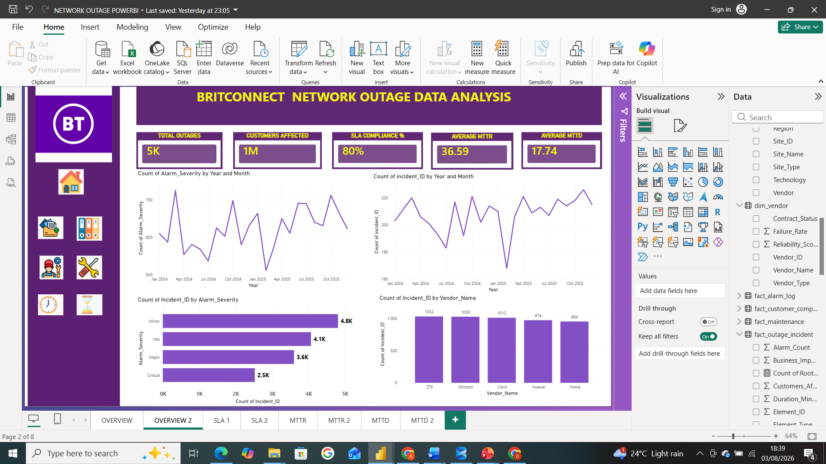
OVERVIEW CONTD
Outage Year and Monthly Trend,
Outages in different Regions.

Slide 7
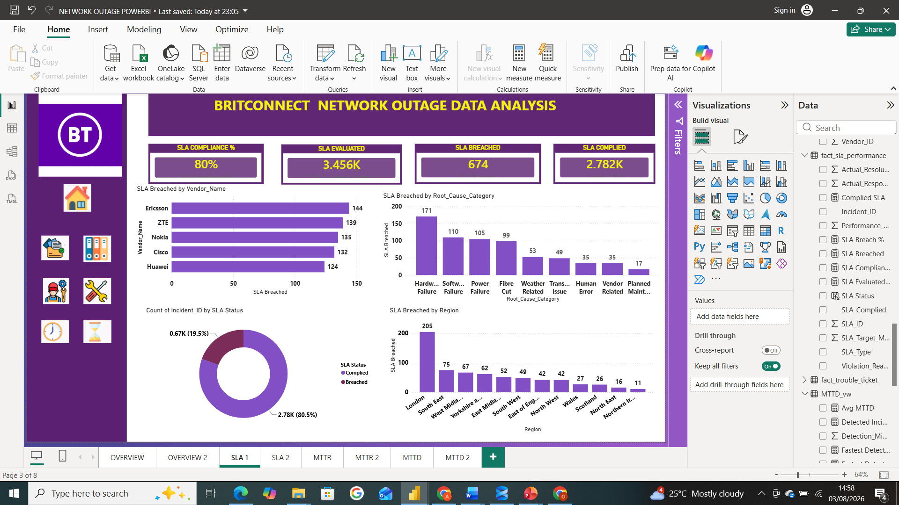
SERVICE LEVEL AGREEMENT
Root Causes
Technology
Site Type
Outages
Vendors
Regions

Slide 8
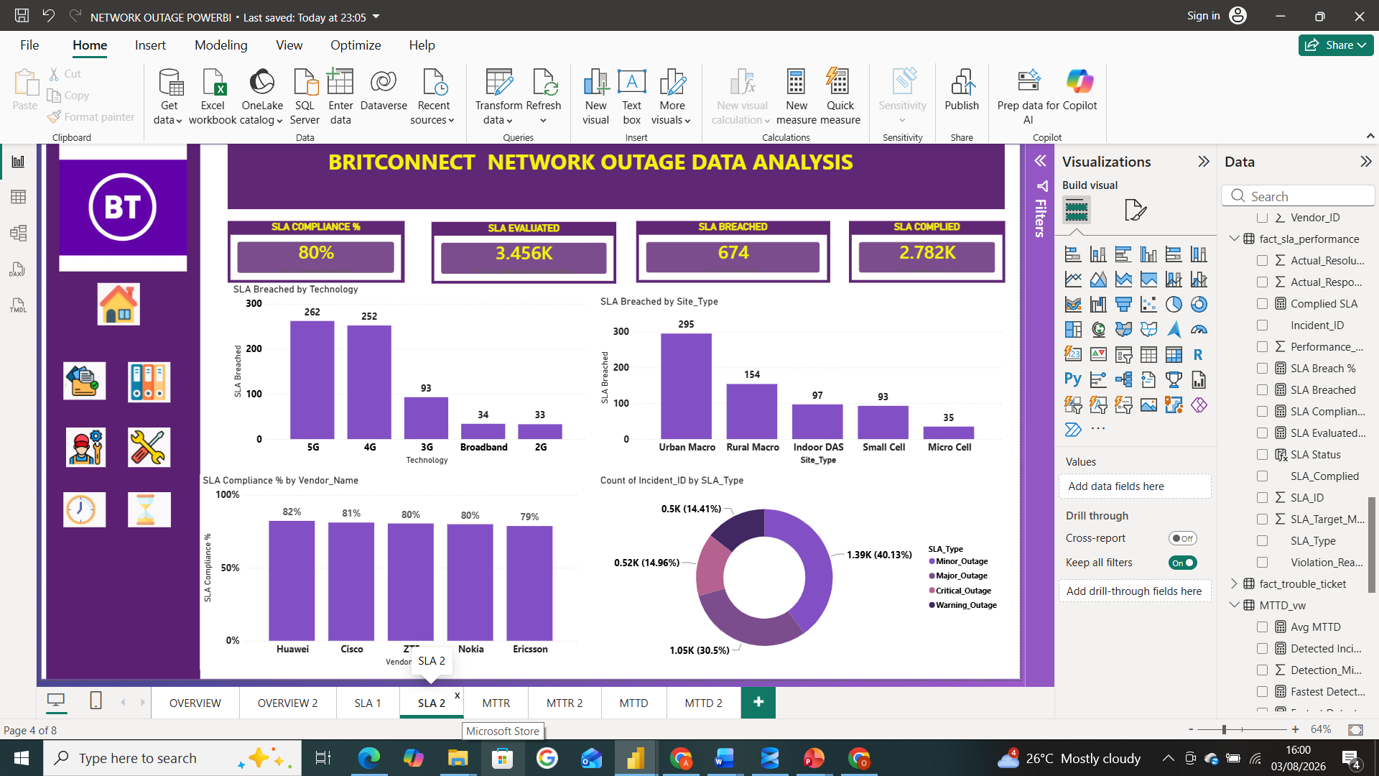
Service Level Agreement CONTD

Slide 9
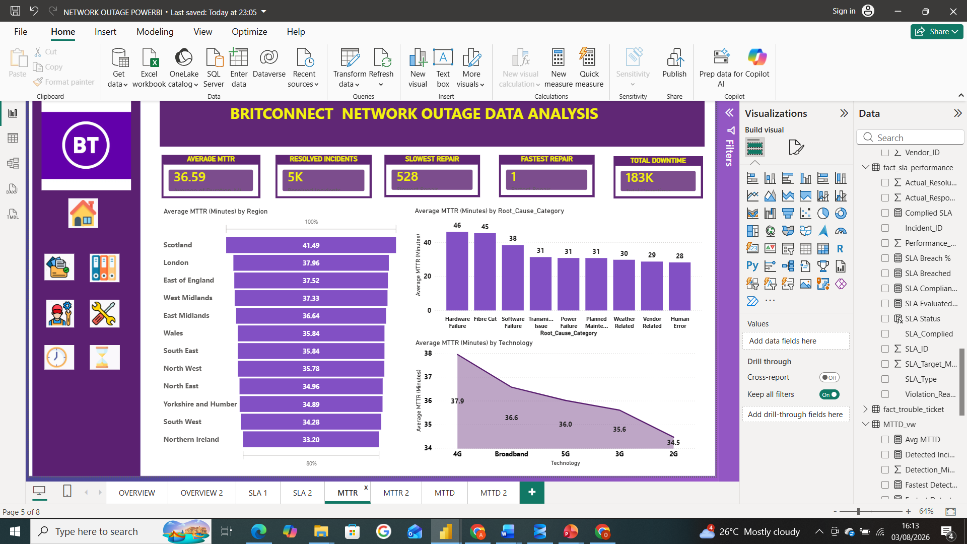
MTTR Analysis
By region
By root cause
BY TECHNOLOGY
Monthly repair trend
By vendor
BY SEVERITY

Slide 10
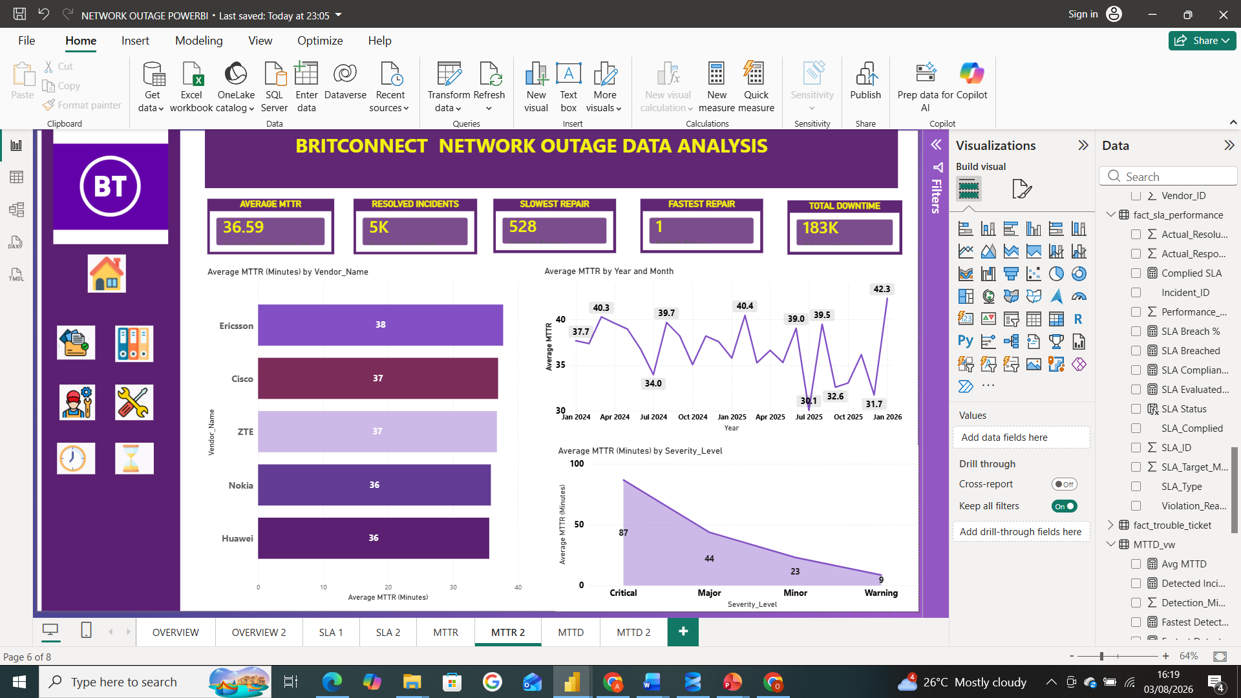
MTTR ANALYSIS CONTD

Slide 11
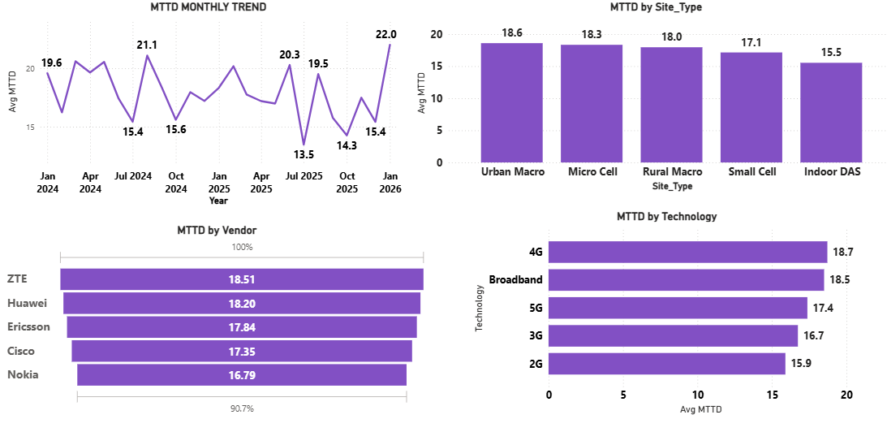
MTTD Analysis
Month-year detection trend
By site type
By vendor
By Technology
Root cause
Severity level
Region

Slide 12
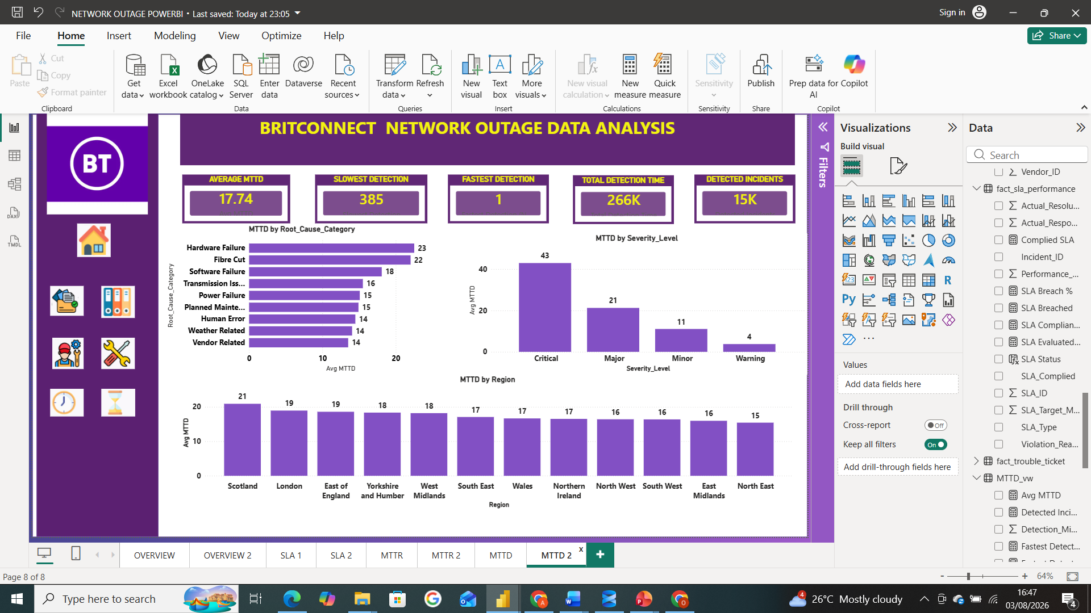
MTTD CONTD

Slide 13
Business Recommendations
Business Problem Identified | Evidence from the Data | Recommendation
1. Frequent service outages | 5,000 total outages -indicate recurring service disruptions. | Improve preventive maintenance to identify and address infrastructure issues before failures occur.
2. Slow fault detection | Average MTTD = 17.74 minutes, indicating delays in identifying network faults. | Enhance alarm monitoring with real-time alerts and automated event detection to reduce MTTD.
3. Delays in service restoration | Average MTTR is 36.59 minutes, indicating that many incidents take significantly longer to resolve. | Review vendor performance to ensure third-party providers meet agreed response and repair times.

Slide 14
Business Recommendations
Business Recommendations CONTD
4. SLA performance below target | SLA compliance of approximately 80% indicates that some incidents failed to meet contractual targets. | Prioritise high-risk sites to reduce outages and improve SLA compliance.
5. Ongoing service reliability issues | The combination of 5,000 outages, 17.74-minute MTTD, 36.59-minute MTTR, and 80% SLA compliance indicates opportunities for service improvement. | Continue KPI monitoring through dashboards to identify trends, measure improvements, and support continuous service improvement.

Slide 15

DASHBOARD 1

Slide 16
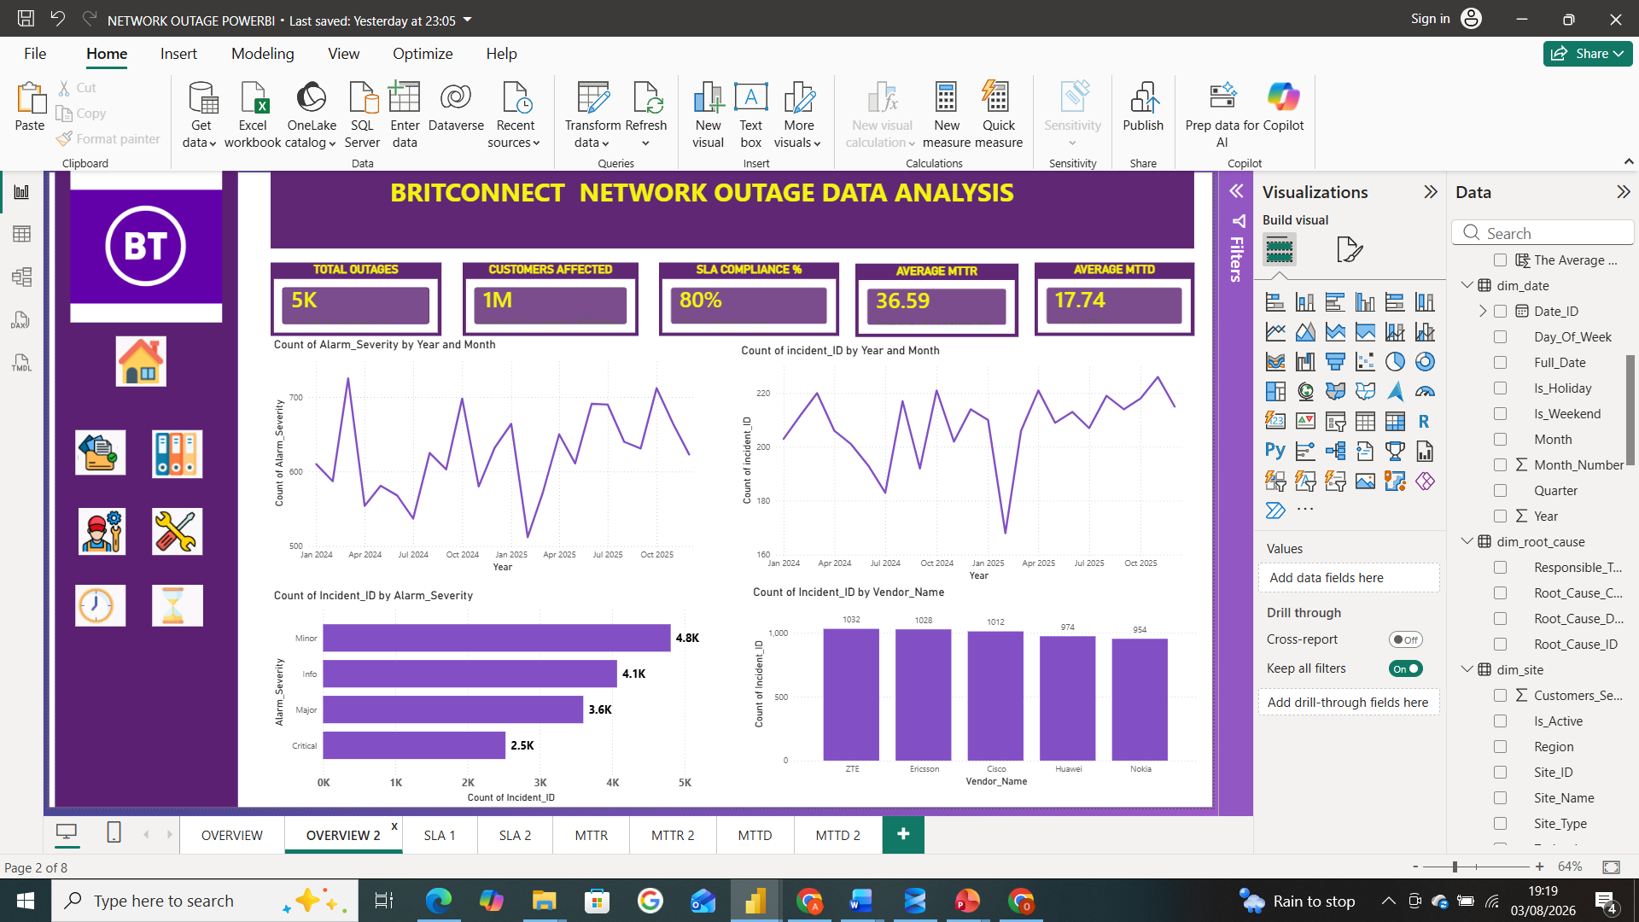
DASHBOARD 2

Slide 17
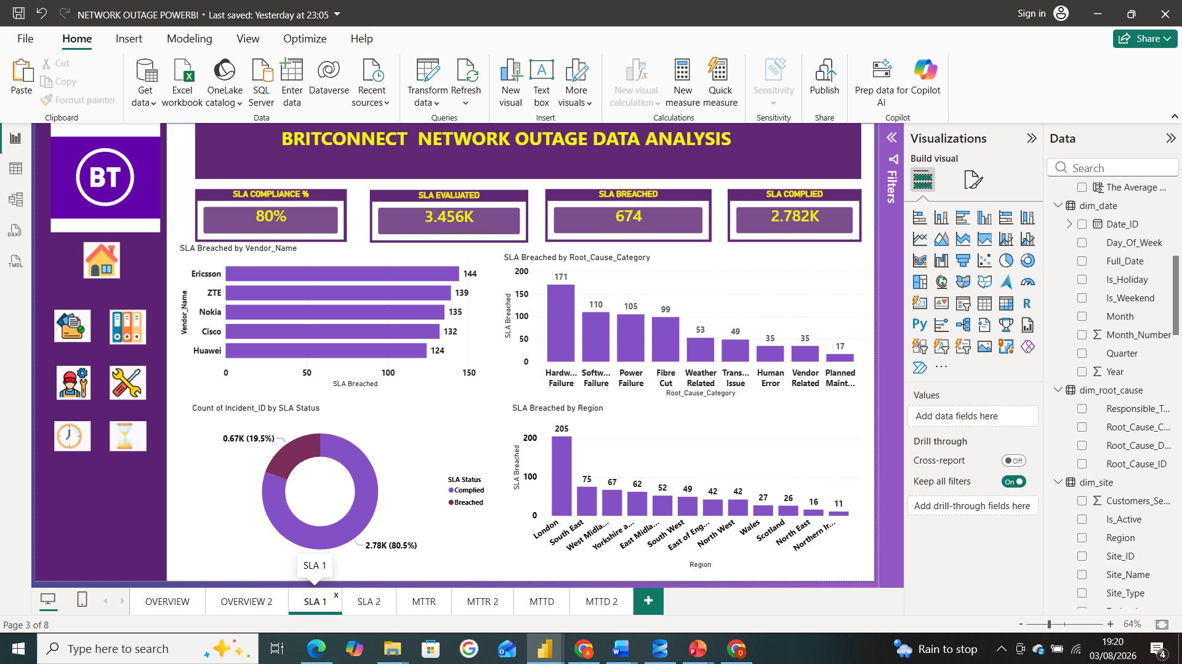
DASHBOARD 3

Slide 18
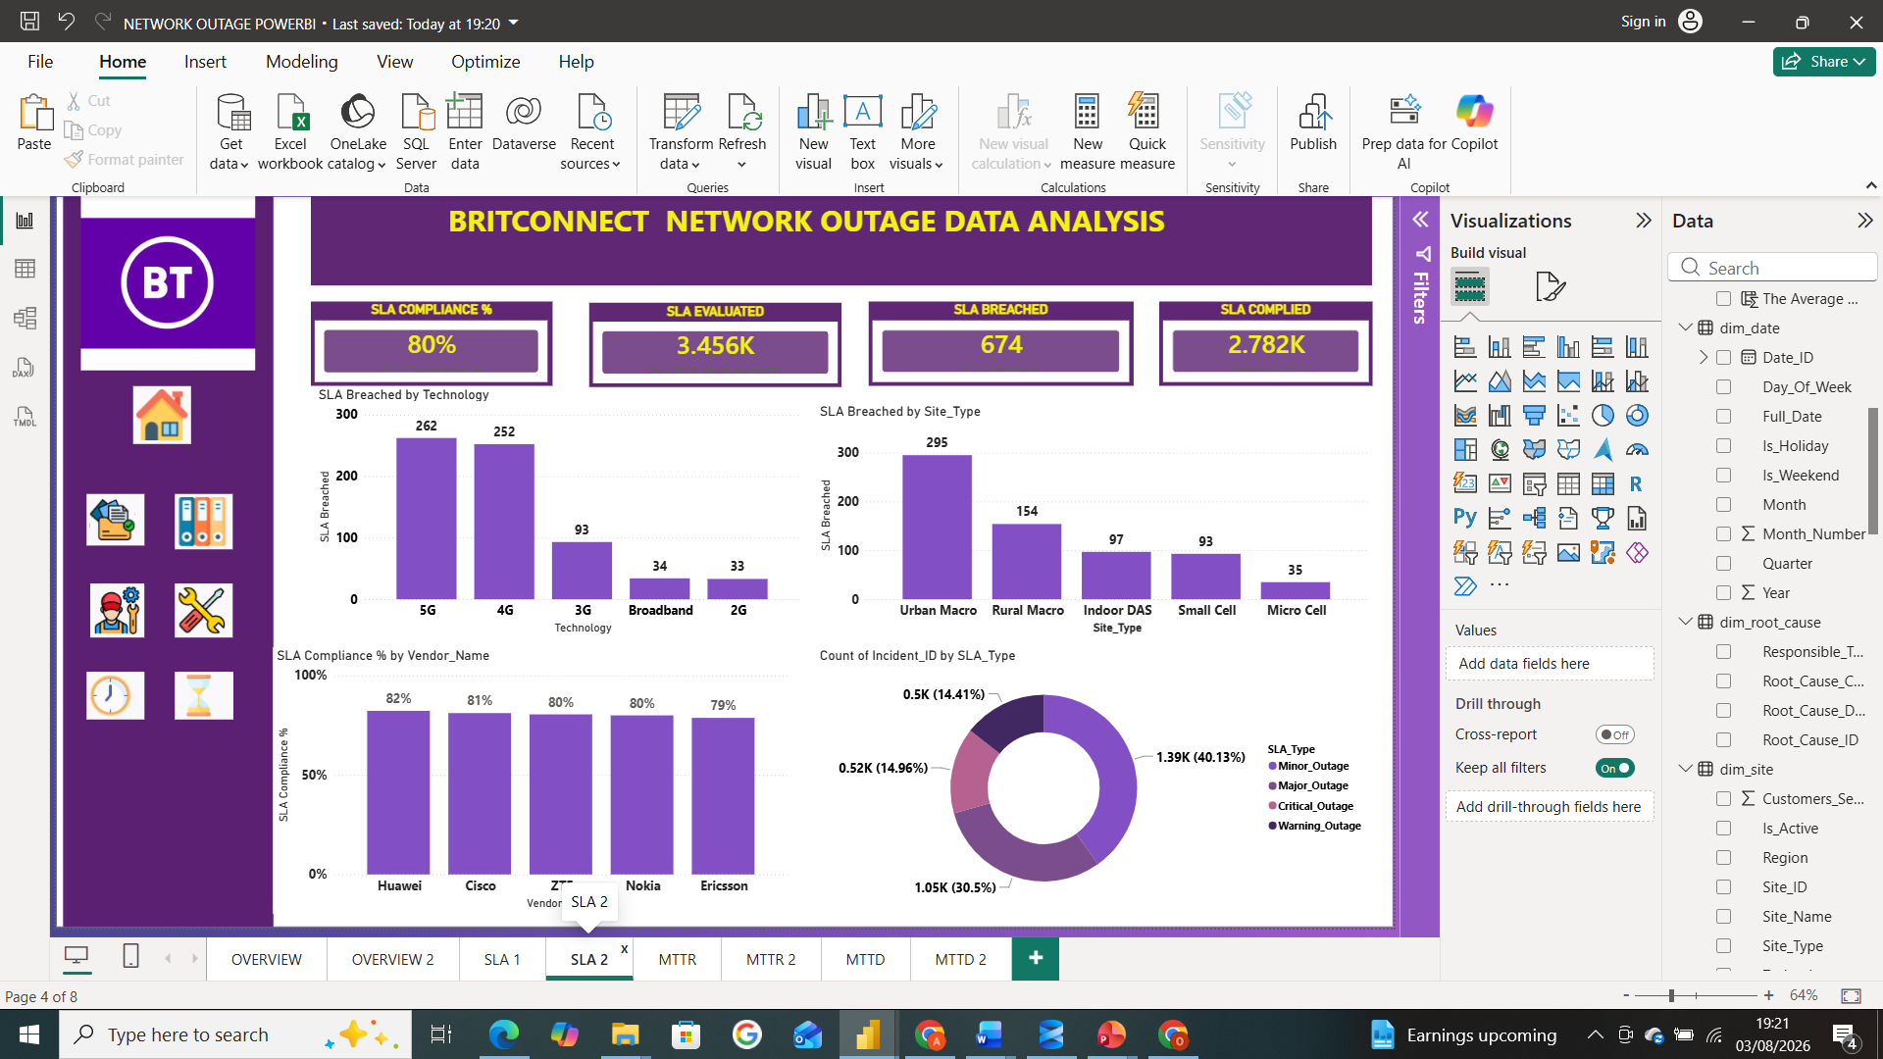
DASHBOARD 4

Slide 19
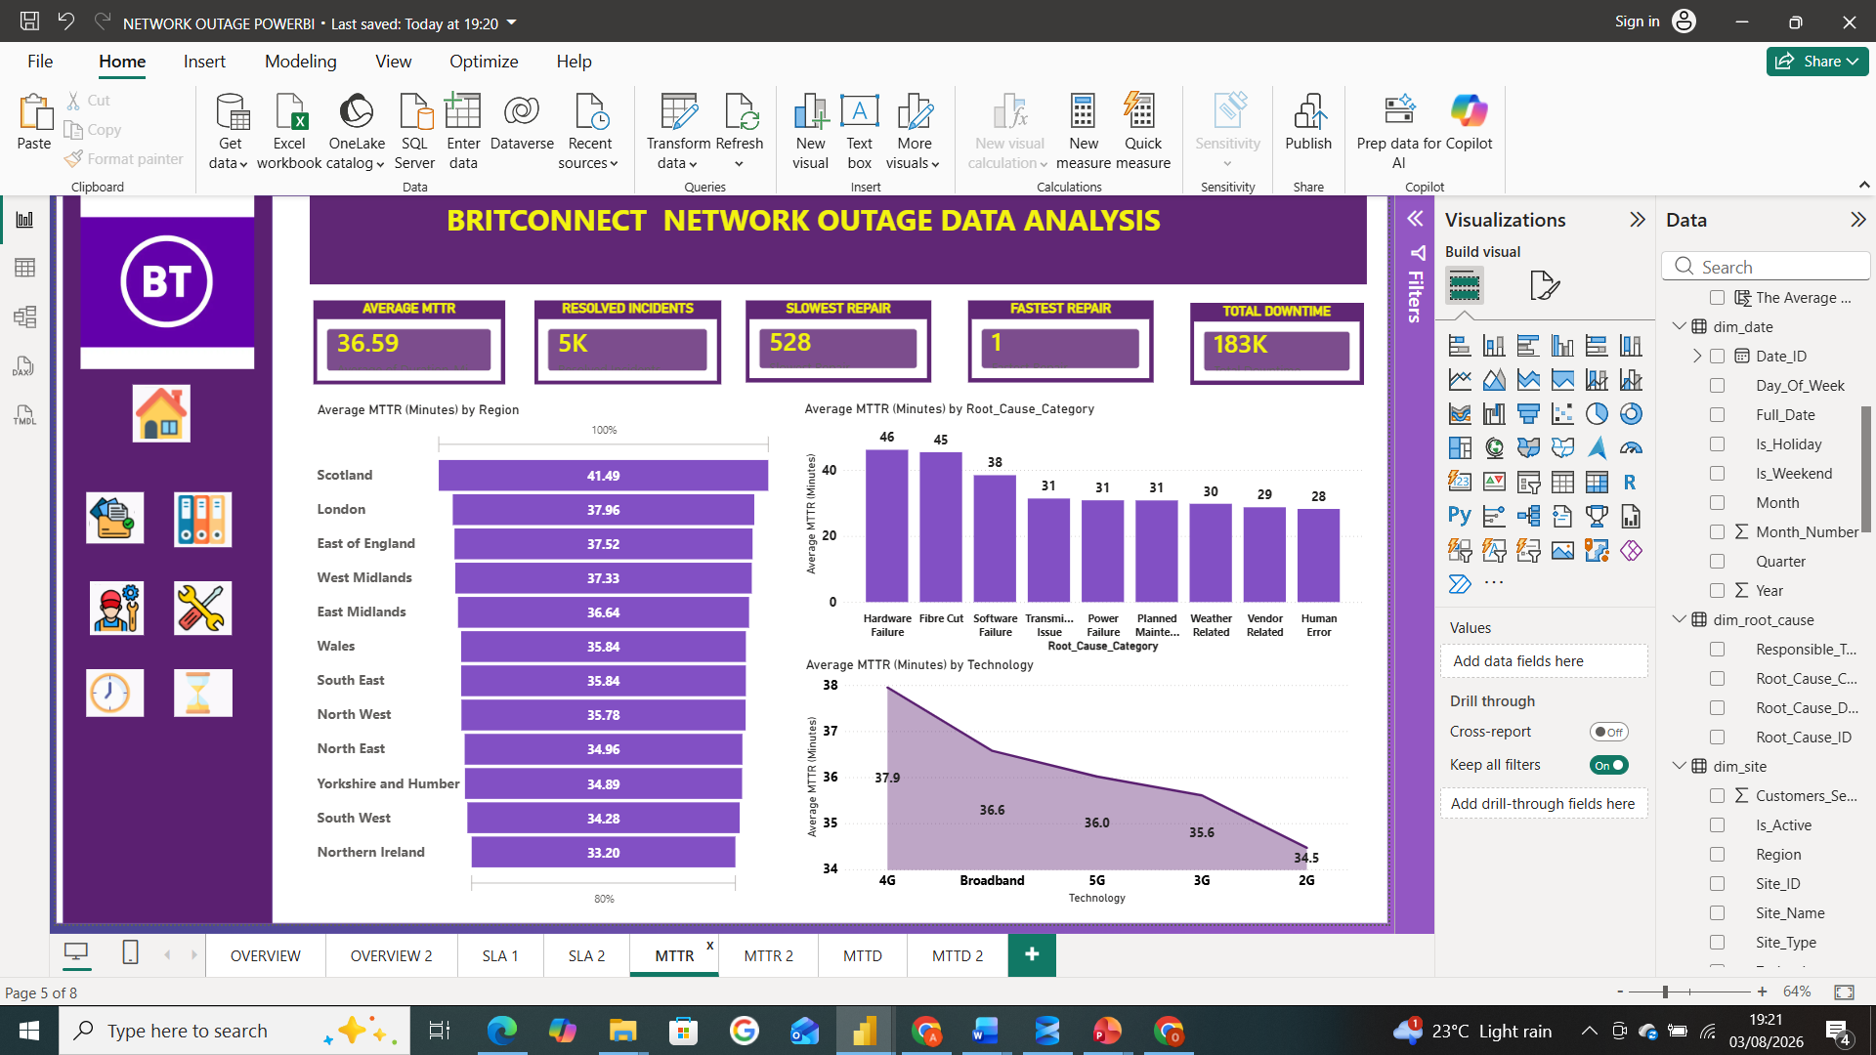
DASHBOARD 5

Slide 20
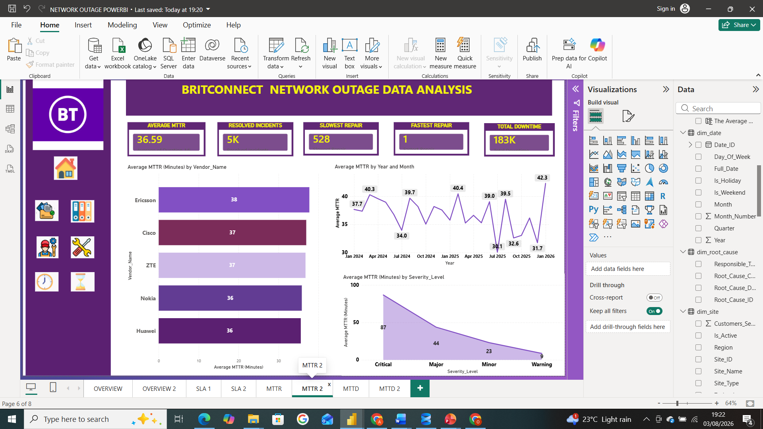
DASHBOARD 6

Slide 21

DASHBOARD 7

Slide 22
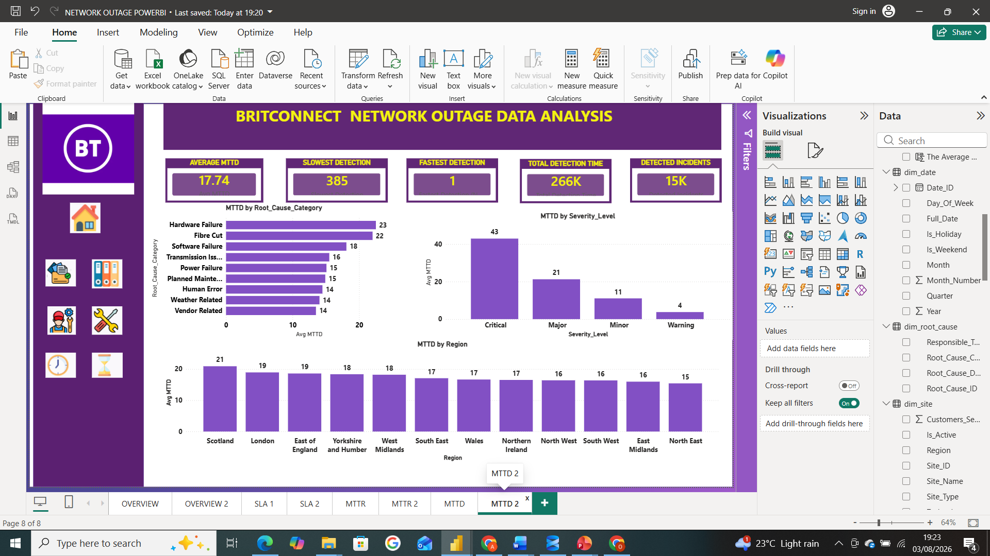
DASHBOARD 8

Slide 23
THANK YOU

